Slide 1
Managing Projects
Project Organization, Leadership, and Control

Slide 2
Project Organization
In a project driven organization, such as construction or aerospace, all work is characterized through projects, with each project as a separate cost center having its own profit and loss statement. The total profit of the corporation is simply the summation of the profits on all projects. In a project-driven organization, everything centers around the projects. In the non-project-driven organization, such as low-technology manufacturing, profit and loss are measured on vertical or functional lines. In this type of organization, projects exist merely to support the product lines or functional lines. Priority resources are assigned to the revenue-producing functional line activities rather than the projects.

Slide 3
Elements of the Project-Driven Organization
The project office
Project manager alone may serve this function
Larger project has project engineer, project administrator
Key functional support
System analysis, system engineering and integration
Product design, quality assurance, production planning
Installation, testing, training
Manufacturing and routine administration
Less likely to be under direct project control as its expensive to replicate for each project
Manufacturing, accounting & finance
Plant facilities and maintenance
Future business
Non-project-specific R&D and marketing

Slide 4
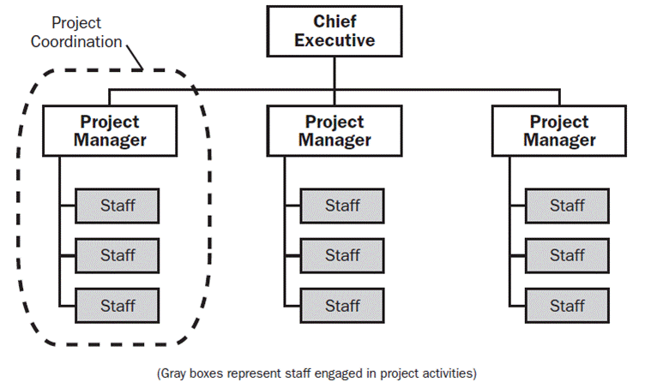
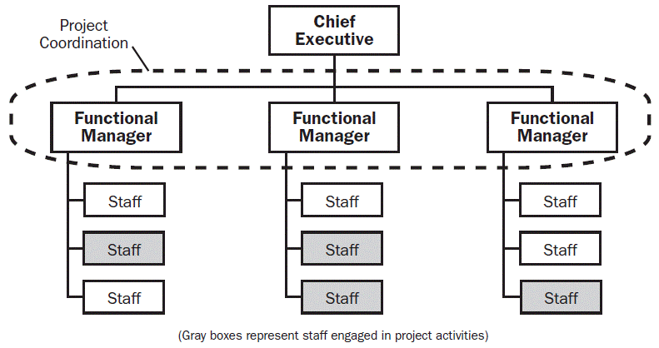
Projectized versus Functional Organizations

Slide 5
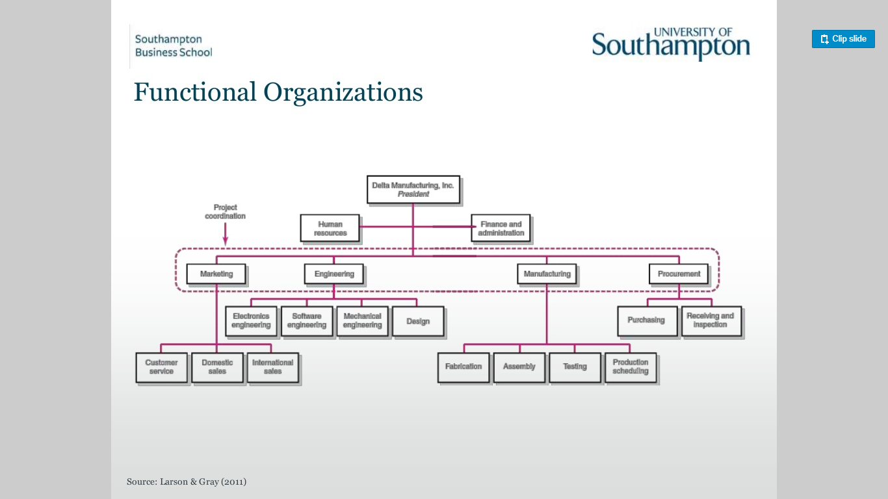

Slide 6
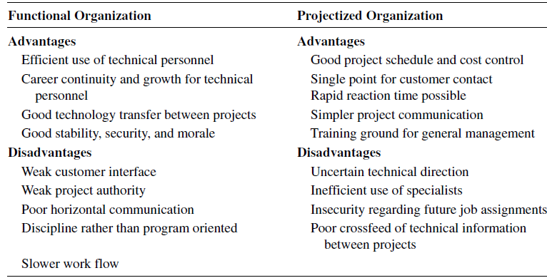

Slide 7
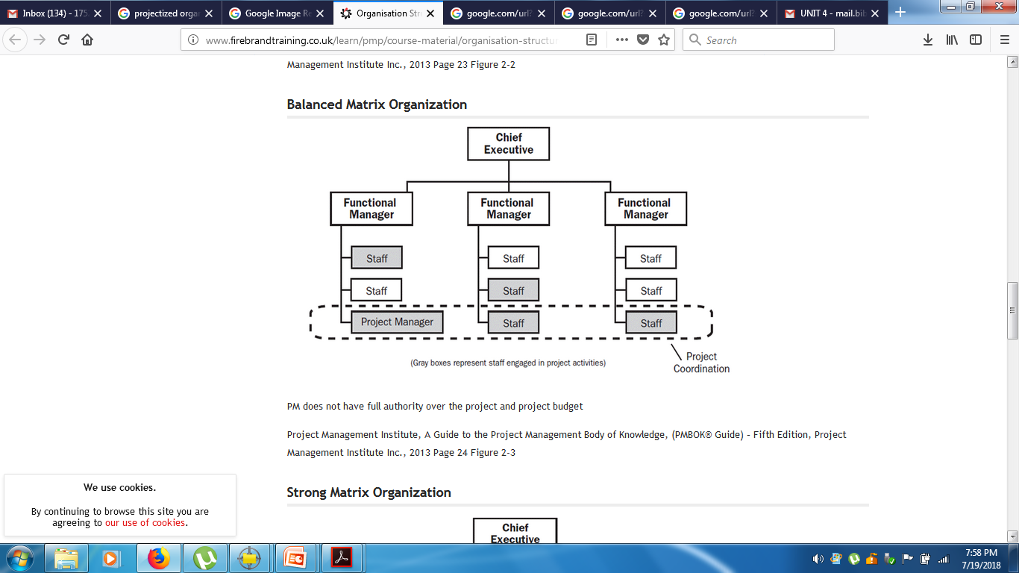
Matrix Organization

Slide 8
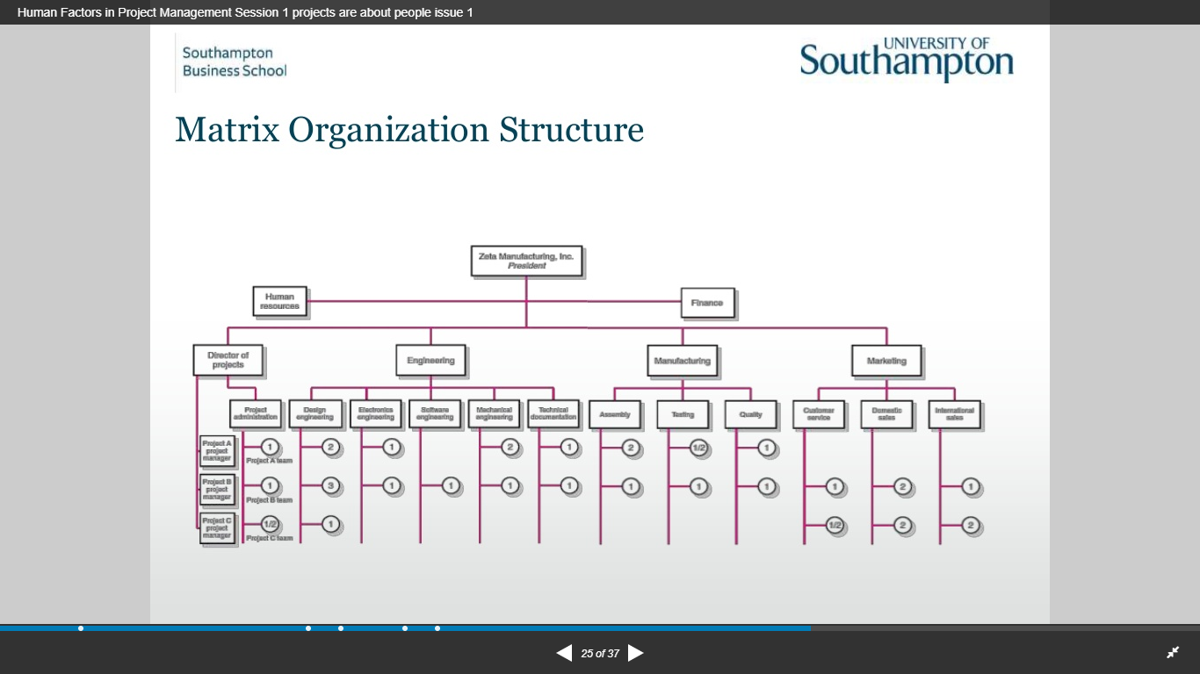

Slide 9
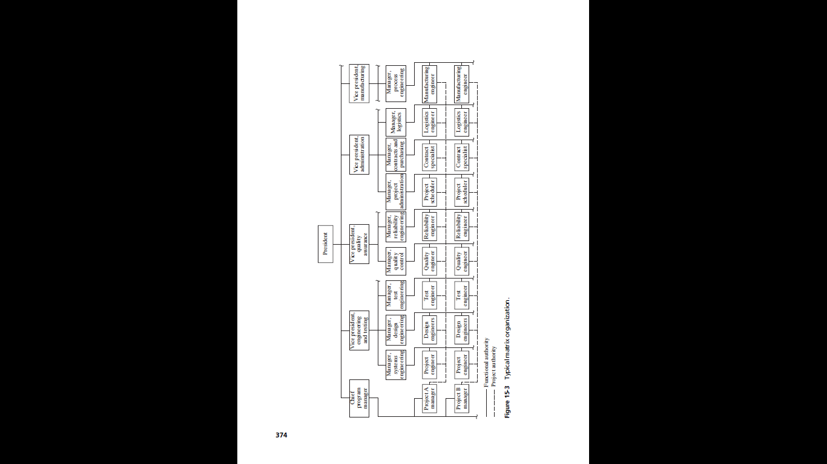

Slide 10
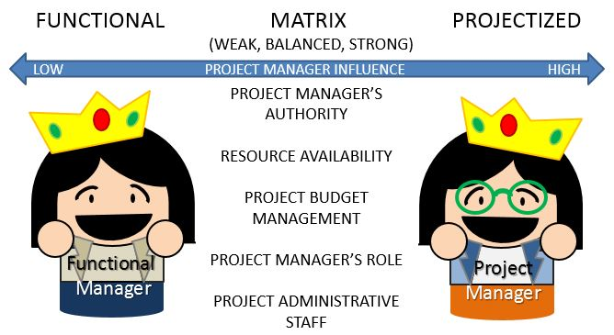

Slide 11
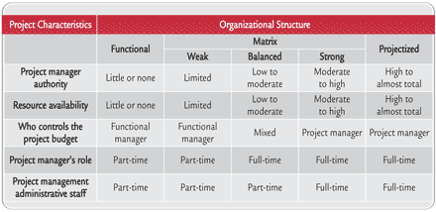

Slide 12
Organization Structure and Project Success
Functional organization
Functional matrix
Balanced matrix
Project matrix
Project team

Slide 13
Characteristics of Effective Project Manager
Enthusiasm, stamina, and an appetite for hard work to withstand the special pressures of project management.
Seniority and position in the organization commensurate with that of the functional managers.
Blend of technical, administrative, and interpersonal skills.

Slide 14
Motivating Project Performance
Team building
Managing conflict
Keys to project success
Customer communications
Early learning path

Slide 15
Team Building
Building the project team is one of the prime responsibilities of the project or program manager. Team building involves a whole spectrum of management skills required to identify, commit, and integrate various task groups from traditional functional organizations into a single program management system. This process has been known for centuries. However, it becomes more complex and requires more specialized management skills as bureaucratic hierarchies decline and horizontally oriented teams and work units evolve.

Slide 16
Managing Conflict
Sources of Conflict
Conflict over schedules
Conflict over priorities
Conflict over work-force resources
Conflict over technical opinions
Conflict over administrative procedures
Conflict over personality
Conflict over cost

Slide 17
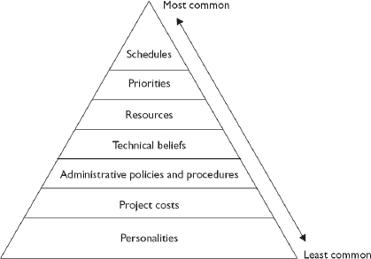

Slide 18
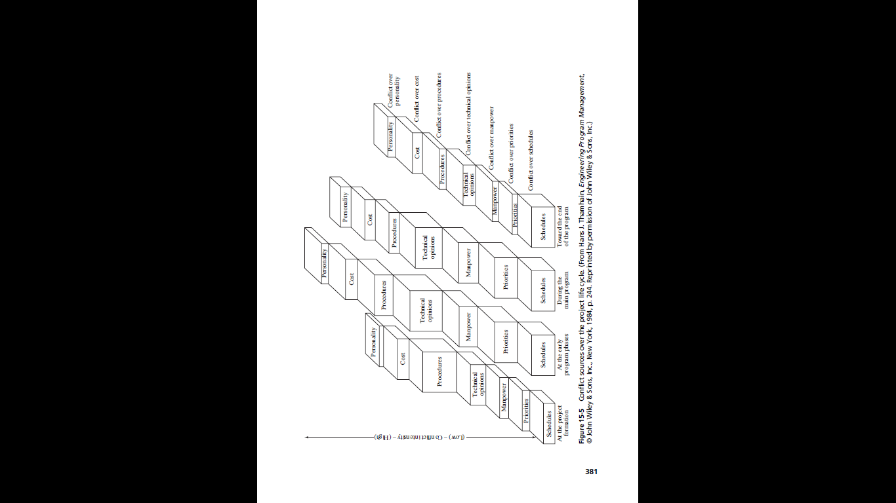

Slide 19
Methods of Conflict Management
(Blake and Mouton)
Withdrawal
Forcing
Smoothing
Compromising or negotiating
Confronting or problem solving

Slide 20
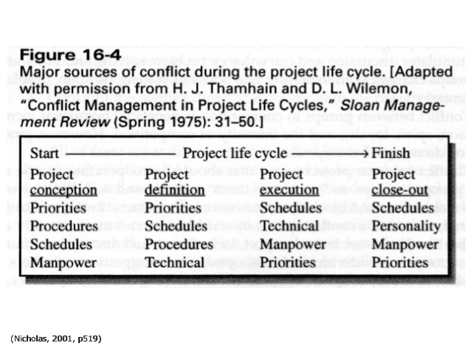

Slide 21
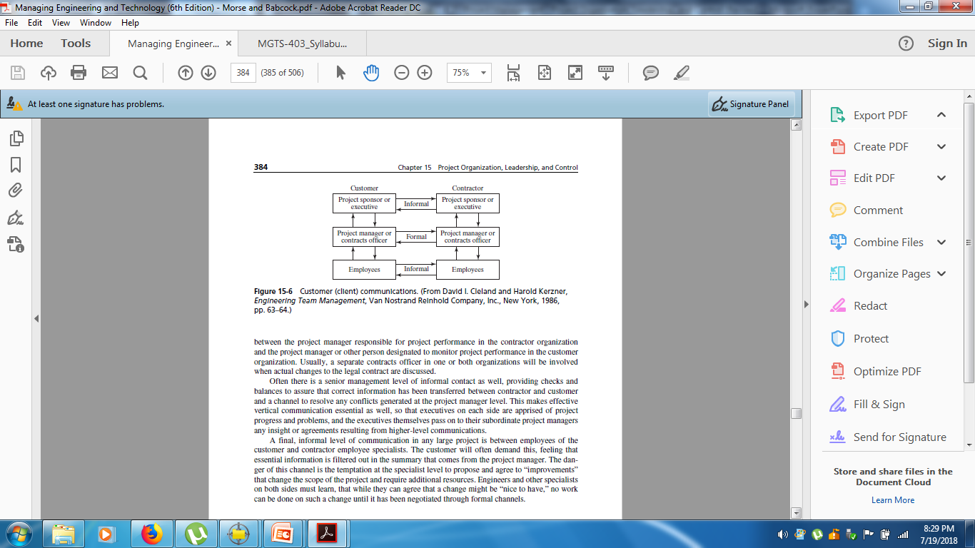
Customer Communications

Slide 22
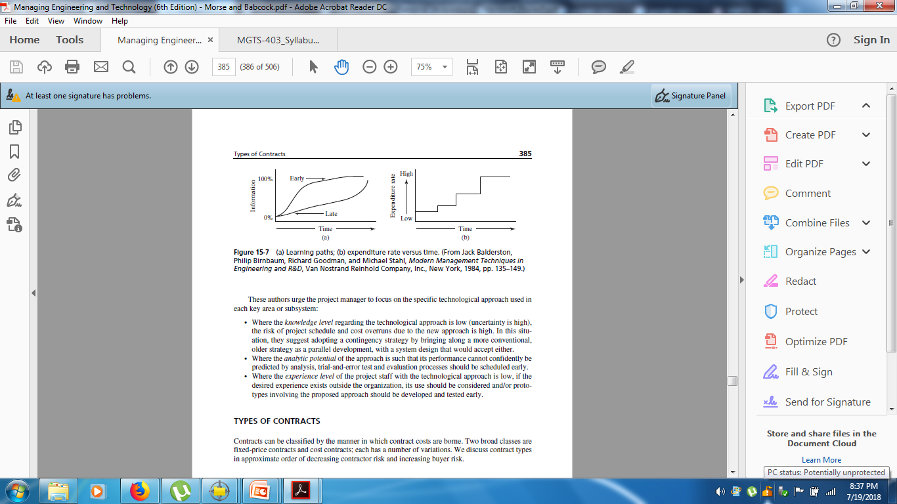
Early Learning Path

Slide 23
Types of Contracts
Fixed Price Contract
Firm fixed price contract
Contractor alone enjoy profit or suffers loss
Fixed price with escalation contract
Increment in price of Labour and material cost within the project life is addressed
Fixed –price , re-determinable contract
Adjustable to actual cost later
Fixed- price incentive contract
Contractor and buyer share saving within a certain range, but establish a maximum cost for the buyer above which the contractor bears the total risks

Slide 24
Cost Type Contract
Cost plus incentive fee contract
Estimate the target cost and incentive
Within a specified range about the target, contractor and buyer share added costs or savings in an agreed ratio
Cost plus fixed – fee
Buyer requires to pay all costs, plus an agreed upon fee
Time & material contracts
Letter contract

Slide 25
Types of Contracts in Project
Turnkey Contract
Project executing responsibilities over contractor
Hand over “key” of the completed project
Lump sum Contract
The contractor executes the complete project for an agreed sum of money
Cost- Plus Contract
Actual cost plus materials plus certain percentage above the cost
Piecework Contract
Given for small works at a specified rate. E.g. Earth excavation
Labour Contract
Supply of labour only
Sub Contract
Main Contractor entrusts specified works to subcontractor

